Slide 1
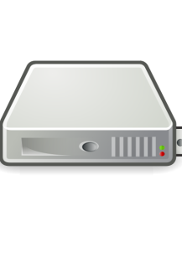



Internet
Single (multiple) server(s) in the enterprise domain
Internet
Single server / Rack of servers in the Telecom POP
Home Gateway + rack of servers in the Telecom POP + telecom data center
Internet

